Slide 1
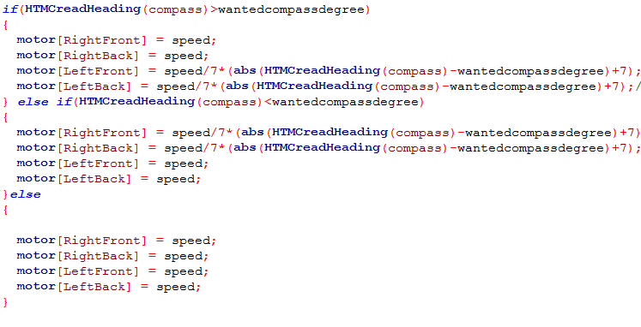
7350 Team Watt NXT, Edison New Jersey
Title: New Compass Sensor
Page Number
Problem: Robot does not turn the exact amount of degrees that we want it to; When we want it to go straight, it curves significantly.
Solution: Integrate a compass sensor to adjust the motor values whenever the robot doesn’t go the desired direction.
This key piece of code drives the right side faster if the robot is going towards the right and drives the left side faster if the robot is turning to the left.
Recorded by Sign Date
Time Start Stoph

